Slide 1
Using Equipment to Find Life on Mars
By Matthew Katterman

Slide 2
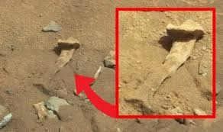

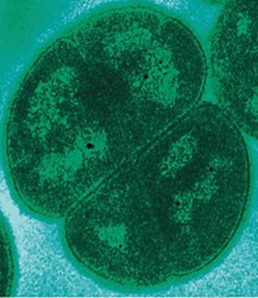
Life on Mars?
Was there life on Mars in the past?
Is there life currently on Mars?

Slide 3
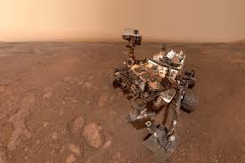
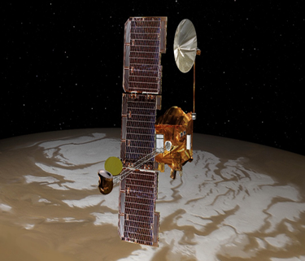
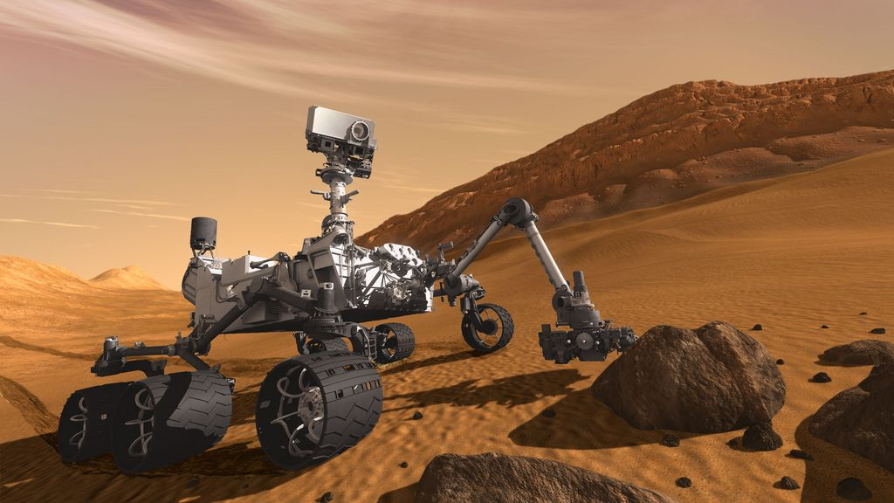
Mission Approach
Choose approach
Did life exist on Mars?
Does life exist now on Mars?
Make a plan for what mission equipment you want to use.
Start from space first then use equipment on the surface.
Will use the Odyssey Orbiter
Will use the Curiosity Rover
Choose between Reconnaissance Orbiter and Insight Lander
Odyssey Orbiter
Curiosity Rover

Slide 4

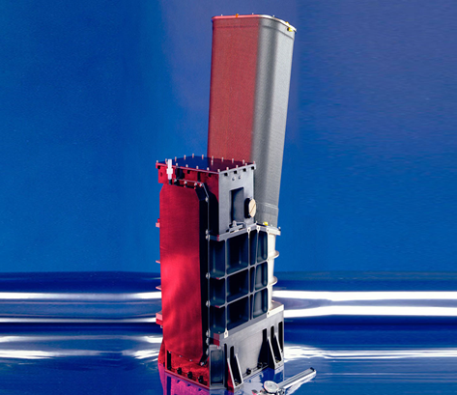
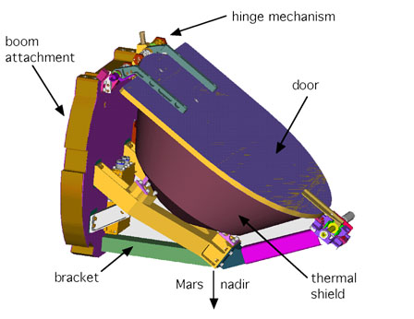
Scientific Approach – Finding the Presence of Water
Look for potential water source from space
Geological structures that formed in the presence of water in the past.
Spotting water or ice beneath the surface that exists now.
Thermal Emission Imaging System –
The ability to map the surface for the distribution of minerals that are only able to form in the presence of water.
Gamma Ray Spectrometer –
From space it can detect the presence of water or ice in the soils up to 1 meter below the surface.
Odyssey Orbiter

Slide 5
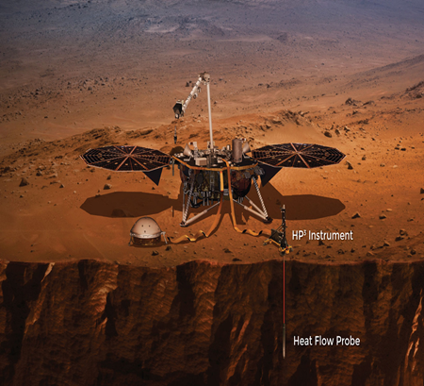

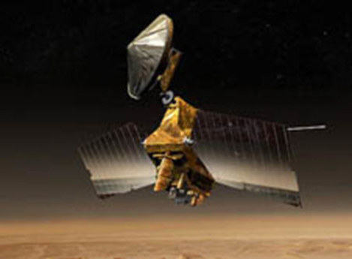
Energy sources for Life
Life in the past may have used chemical energy sources in the form of oxides.
Choose the Reconnaissance Orbiter if looking for life in the past that may have used minerals for chemical energy.
In the presence of water, current geothermal sources may be likely to contain life (much like geysers).
Would use the Insight Lander to locate specific areas underground that contain high sources of geothermal energy.
Reconnaissance Orbiter

Slide 6
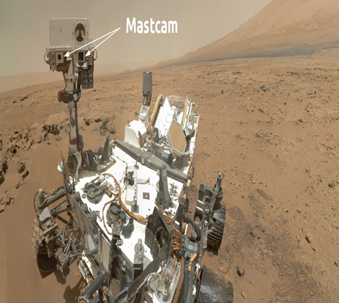
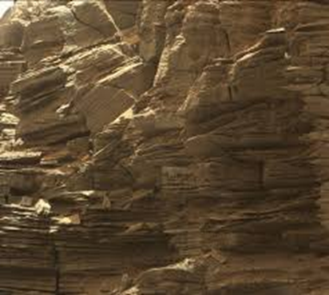
Looking for water or rocks/minerals
Use the Rover for three purposes
(1) Find the general location of where soil with water or ice may be or where water once flowed that can be evidenced by geological formations.
These are found near gullies or layered deposits.
The Odyssey orbiter gave you the general location where water is underneath the surface.
Have a camera to find more specific location.
Rover Mastcam –
Takes color images and videos of the landscape to help identify areas where water may have flowed or may be present.

Slide 7
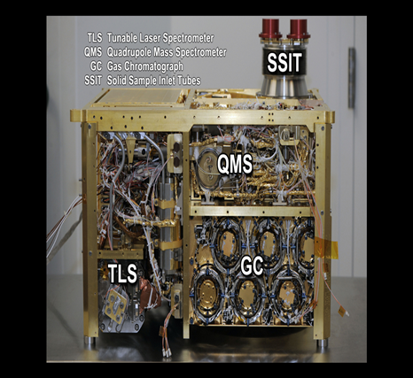
Finding evidence of Life
(2) Use Instrumentation on the Rover to find Minerals or exact locations of Water/Ice Deposits
Looking for specific rocks or minerals that have either carbonates or oxides.
Use neutron source to find exact location below the surface where water or ice layers exist.
(3) Use Instrumentation on Rover to find carbon compounds that show evidence of life or past life.
The presence of Methane shows bacteria could currently exist.
Organic compounds (made of carbon) showed that life existed or exists now.
Sample Analysis at Mars Instruments – Using three instruments it searches for compounds that contain carbon in them such as methane and amino acids.

Slide 8
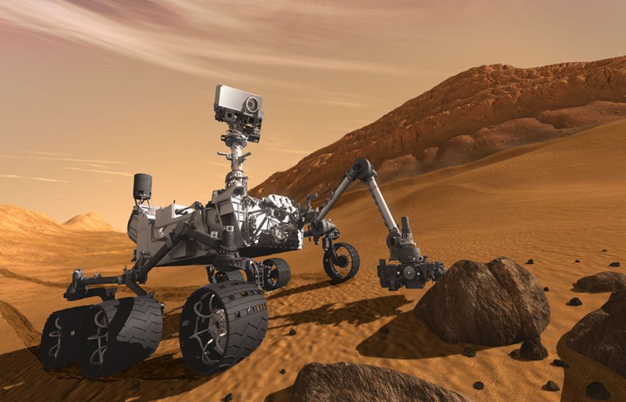
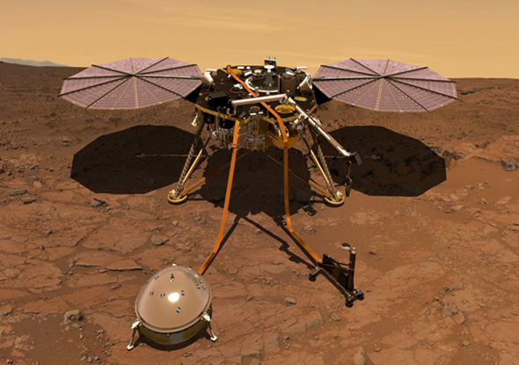
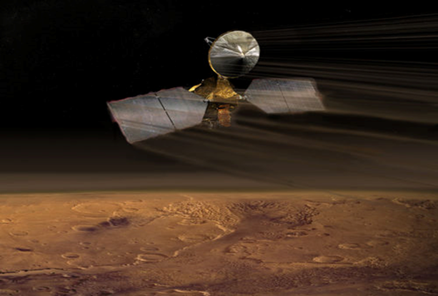
SPECIFIC EQUIPMENT USED IN ROVERS, ORBITERS and LANDERS TO FIND LIFE
Curiosity Rover Odyssey Orbiter Insight Lander Reconnaissance Orbiter

Slide 9

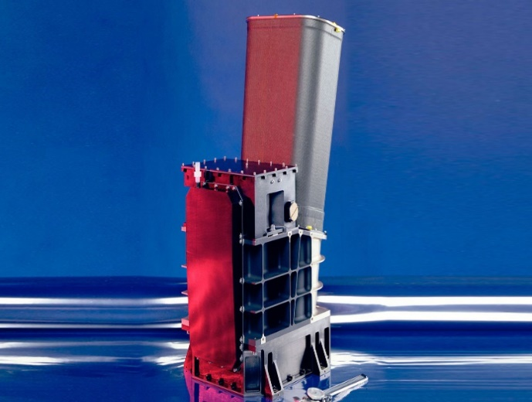
Finding Evidence of Water on Mars
If Finding Life that Now Exists If Finding Life that Existed
Gamma Ray Spectrometer Thermal Emission Imaging System
From space it can detect the presence of water or ice in the soils up to 1 meter below the surface.
This equipment has the ability to map the surface for the distribution of minerals that are only able to form in the presence of water.

Slide 10
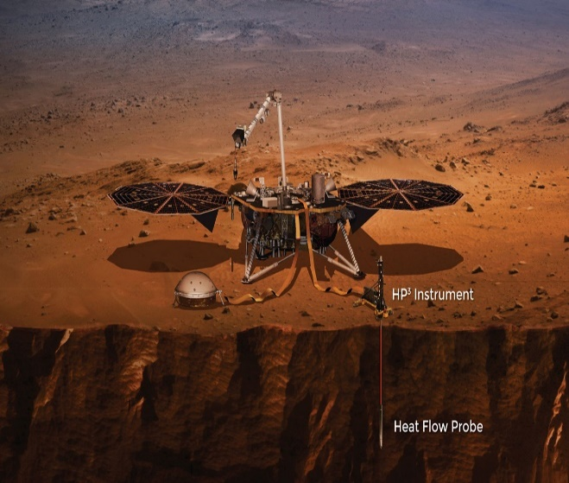
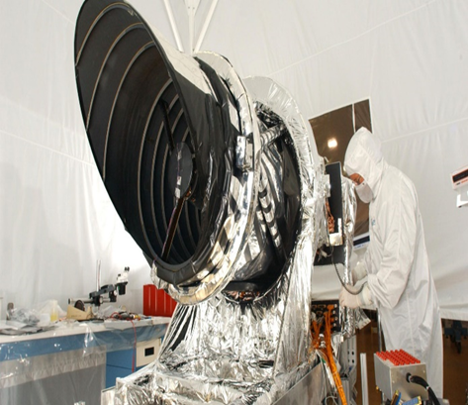
Energy Sources for Possible Life on Mars
If Finding Life that Now Exists If Finding Life that Existed
Heat Flow Probe High Resolution Imaging
Measures the temperature deeper underneath to surface to help identify where sources of geothermal energy may be located.
Takes images of small objects in terrain such as gullies and layered deposits from space & can identify the kinds of minerals that may provide chemical energy.

Slide 11
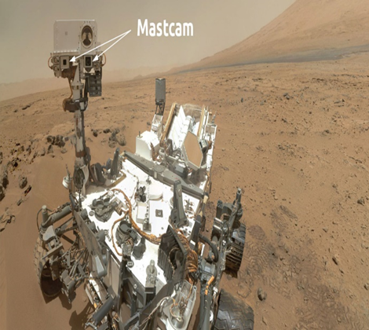
Using Rover Camera to find a General Location
Rover Mastcam
If Finding Life that Now Exists If Finding Life that Existed
The camera specifically looks for the best locations on the surface to find water underneath the ground based on the area that the Gamma Ray Spectrometer found from space above.
The camera specifically looks for land formations such as gullies or layered rock deposits that indicate water may have flowed in the area in the past.

Slide 12
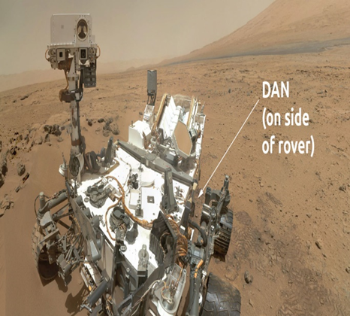
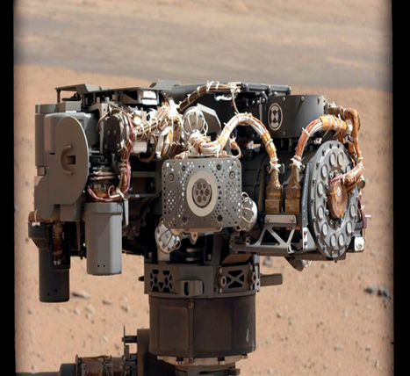
Finding Water Beneath the Surface Finding Carbonate or Oxide Minerals in the Soil
If Finding Life that Now Exists If Finding Life that Existed
Dynamic Albedo of Neutrons Alpha Particle X-Ray Spectrometer
Detects if the minerals and soil beneath the surface contain water in them using radiation, and whether there are layers of ice below.
Detects the chemical elements contained in rocks and minerals such as oxygen that make up oxides and carbonates.

Slide 13
Finding Carbon Compounds to show that life (exists or existed)
Sample Analysis at Mars Instruments
Using three instruments it searches for compounds that contain carbon in them such as methane and amino acids.

